Slide 1

Sym✓
Fall 2020 Capstone project | Professor Henry Wong
Alan singleton, briana Figueroa, jasmine Washington, morgan franklin, sayema islam, swapnil kadekar
DELIVERABLE 2

Slide 2
Agenda
Overview
01
Minimal Viable Product
02
Technologies Used
03
User Stories
04
Acceptance Criteria
05
Test Cases
07
Sprint Backlog
08
Product Backlog
09
Retrospectives
10
Future Tasks
Mock-Up Designs
06

Slide 3

Overview

Slide 4
SYMCheck (Sym✓)
During this challenging time of COVID-19, people around the world don’t want to visit public places unless necessary.
According to the CDC, from May 14 to June 21, various hospitals have identified 5,142 coronavirus infections acquired inside hospitals.
Our project is a web application that allows users to self-diagnose themselves by uploading an image of their illness area.
Our application may reduce the traffic inside hospitals by providing diagnoses of mild illnesses.

Slide 5

Minimal viable product (MVP)

Slide 6

MVP
Image Recognition of illness
Percentile Results based on likeliness of illness
Recommended course of action depending on results
Quick and easy method for finding the nearest emergency room
STEP 1
Uploading Image...
STEP 2
Processing Image...
STEP 3
Image Results!

Slide 7

Technologies used

Slide 8




Technologies used
Python
TensorFlow
Keras
Django (Web Framework)
HTML
CSS
JS

Slide 9

ALAN

Slide 10
User stories (Homepage)
ID | As a | I want to | so that
US1 | user | know that I have reached the correct page to use the SYMCheck application | I can be sure I am uploading my picture to the correct place and receiving the recommendations/care that I desire
US2 | user | be diagnosed by the SYMCheck web application | I can gain a cursory understanding of what might be causing my symptoms/what the potential recommendations might be

Slide 11
User stories (User input page)
ID | As a | I want to | so that
US3 | user | upload a photo/image of my symptom/affected area/illness | the SYMCheck application can diagnose me and I can gain insights as to what I might be afflicted with
US4 | user | be sure that my image has been uploaded successfully | I can be sure that the image will be processed by the application so that I can receive recommendations for my care
US5 | user | submit my image for assessment | I may receive a[n accurate] determination of my affliciation as well as recomendations for care
US6 | user | know if I am in a critical condition or in need of immediate medical attention | I am able to seek medical care as soon as possible if there is no time to waste!
US7 | user | find the nearest emergency room | I can seek immediate medical attention for what I deem to be an extremely critical/dire/time-sensitive condition
US8 | user | return to the homepage | I can re-read the SYMCheck mission statement, disclaimer, etc.

Slide 12
USER stories (results page)
ID | As a | I want to | so that
US9 | user | know what my symptoms indicate/what my affliction might be | I can gain an understanding of what might be causing my symptoms, and thus make an informed decision
US10 | user | know what information I can obtain about this/any illness I might potentially have | I can gain an understanding of what might be causing my symptoms, and thus make an informed decision on how best to go forth with my care
US11 | user | know whether or not I should see a doctor | I can gauge how much of a PRIORITY a visit to a doctor/medical facility is based on the general nature of my symptoms/illness/affliction
US12 | user | find the nearest emergency room | I can receive immediate medical attention if it is deemed necessary
US13 | user | receive another diagnosis for another affliction/repeat the diagnosis for this one | so that I can upload another photo/set of symptoms for a different or the same illness (i.e. for confirmation of the latter)
US14 | user | navigate back to the home page | to manually start over, or to read SYMCheck's mission statement
US15 | user | be aware of the quality/accuracy of the results given relative to those from a medical facility/medical professional | I do not forget that all results are simply cursory recommendations based on past data
US16 | user | get in touch with the creators of the SYMCheck application | I can provide the creators of the SYMCheck application with suggestions/comments, ask them questions, commend them for their product, etc.

Slide 13


Slide 14
Criteria for Homepage
ID | Acceptance Criteria
US1 | The index or home page of the SYMCheck web should clearly display the SYMCheck logo The page should clearly display a welcome message that describes what the application does, and how this is achieved (i.e. what technologies are used) The page should display a disclaimer so the user is made aware of the quality/accuracy of our website when used in lieu of formal healthcare (i.e. it should not be)
US2 | Given that the user is on the homepage, there should be a button that says "Diagnose me now", "Get Diagnosed", or something of that nature that will take the user to the image/symptom/info input page

Slide 15
Criteria for input page
ID | Acceptance Criteria
US3 | Given that the user is now on the user input/image upload page, the page should display a field where the user can upload an image to be analyzed/classified by the SYMCheck application The page should provide information on acceptable image formats, file sizes, etc. The upload field should indicate that an image can be dragged-and-dropped into the image field, or uploaded via browsing of the user's local machine by simply clicking on said field
US4 | After the successful upload of an image to the webpage, the user should see the name of the submitted file, a preview of the image submitted, or even simply a message stating "upload successful"
US5 | Webpage should display a "Submit" button to be clicked after an image has been uploaded Should an image NOT have been uploaded, maybe the submit button should be grayed out/unclickable. Or simply, display a message stating "Please upload an image of your illness/affected area" or "Please check that the image you have uploaded meets the specified requirements"

Slide 16
Criteria for input page (cont.)
ID | Acceptance Criteria
US6 | The webpage should display a set of symptoms that generally indicate a critical or dire condition (i.e. STAT), under which should be displayed a button to find the nearest emergency room/ER
US7 | Given that the user is on the user input page, there should be a button underneath a short list of potential alarming symptoms, that says "FIND THE NEAREST EMERGENCY ROOM," which, when clicked, will redirect the user to Google Maps or some other map application that will find the hospitals nearest the user's indicated location
US8 | The webpage should display a button that says "HOME" that will redirect the user to the index/home page when clicked

Slide 17
Criteria for results page
ID | Acceptance Criteria
US9 | The results page should display the results of the image assessment in percentages of what illness(es) the user may have, with a predetermined cutoff for which percentages should be displayed (i.e. only illnesses with a 70% or higher match will be displayed)
US10 | The results page should contain a field that displays all known information (i.e. stats, severity, home remedies, etc.) about the illness/affliction that shows the highest match
US11 | The results page should contain a SEPARATE field that indicates under what conditions the user should indubitably see a doctor (i.e. age, state of pregnancy, etc.)
US12 | Given that the user is on the results page, there should be a button underneath all the result fields displayed that says "FIND THE NEAREST EMERGENCY ROOM," which when clicked, will redirect the user to Google Maps or some other map application that will find the hospitals nearest the user's indicated location

Slide 18
Criteria for results page (cont.)
ID | Acceptance Criteria
US13 | The results page should display a button that says "START A NEW DIAGNOSIS" or "NEW DIAGNOSIS" which essentially resets the kernel/refreshes the webpage and removes all data pertaining to the current diagnosis This button should take the user back to the image upload page. Please note that this new diagnosis will be INDEPENDENT of any and all diagnoses completed before it
US14 | The results page should display a button that says "HOME" like all the other pages in the SYMCheck application, which the user can click to return to the index/home page of said application
US15 | The results page should definitely display the disclaimer again at the very bottom of the page to remind the user that no matter how accurate the SYMCheck application may turn out to be, the application is, in itself, in no way a replacement for physical medical diagnoses/care
US16 | There should be a separate field that allows the user to send a comment/concern to the creators of the SYMCheck application by email The feedback field should display some guidance message such as "If you would like share your thoughts on our application, click [here] to send an email to our team. We will get back to you within 24 hours during business days. Thank you!” Clicking the "here" hyperlink will open up an email window, with the message to be preset to be sent to the creators of the SYMCheck site

Slide 19

Mock-Up designs

Slide 20
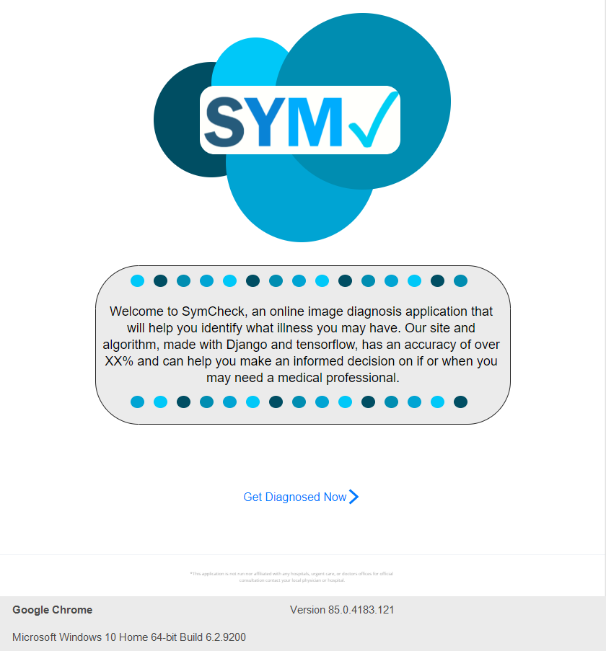
Homepage

Slide 21
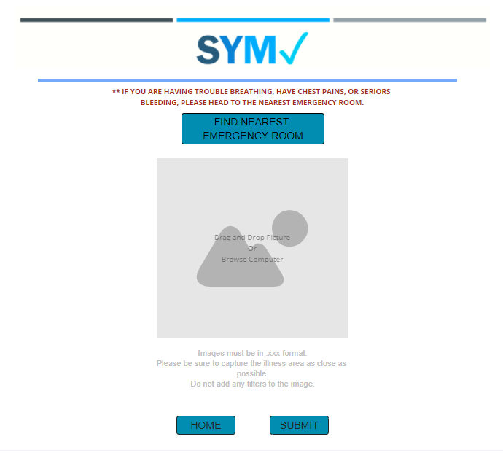
Upload page

Slide 22
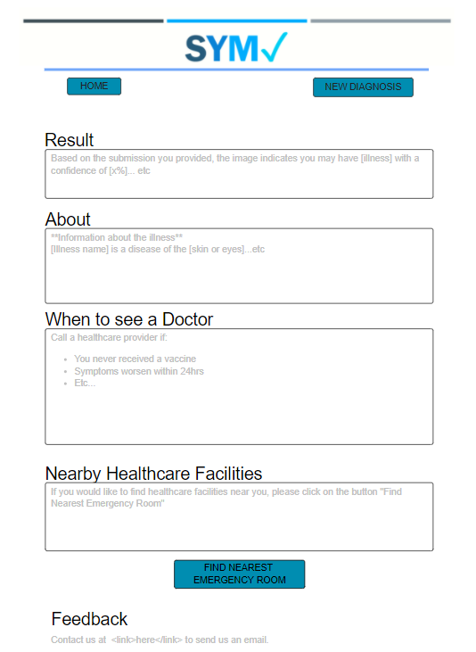
Results page

Slide 23

Test cases (Morgan)

Slide 24
Test cases
Test Case For | ID | Test Cases | Test Data | Expected Results
Homepage | 1 | Browse the Website |  | User should be able to access the homepage of the website
 | 2 | Locate the Get Diagnosed Link |  | User should be able to locate the link to access the upload page

Slide 25
Test cases continued…
Test Case For | ID | Test Cases | Test Data | Expected Results
User Input Page | 1 | Locate the Submit Photo Link |  | User should be able to locate the link to submit photo
 | 2 | Choose file shows up |  | User should see choose file option, to upload photo to website
 | 3 | Drag and Drop feature |  | User can drag and drop the photo in the box for uploading
 | 4 | Ability to cancel uploading file |  | User should be able to cancel the file from being uploaded
 | 5 | Verify file is uploaded |  | User should not be able to click on the submit button without submitting a file
 | 6 | Verify file is correct |  | User should be promoted to verify uploaded file is correct
 | 7 | Submit to website for analysis |  | User should be able to click submit to send correct photo to be analyzed
 | 8 | Locate the Nearest ER Link |  | User should be able to locate and click the Nearest ER link to access an interactive map
 | 9 | Return to Homepage Link |  | User should be able to return to the homepage when clicking the Home button
Image functionality | 1 | Check for image file extension |  | User can only upload certain types of file extensions (Verify if incorrect)
 | 2 | Check for size of the image file |  | If file is too large to upload, the user must be notified
 | 3 | Check for height and width |  | Image should be measuring a certain height

Slide 26
Test cases continued…
Test Case For | ID | Test Cases | Test Data | Expected Results
Results | 1 | Results appear after analysis complete |  | User will see percentage that they have the illness
 | 2 | About the disease |  | User will see facts about the disease they have been diagnosed with
 | 3 | When to see a Doctor |  | User will see when it is best advised to see a doctor
 | 4 | Nearest ER |  | If selected, user will be able to access an interactive map
 | 5 | New Diagnosis Link |  | User should be able to access the user input page for a new diagnosis
 | 6 | Return to Homepage Link |  | User should be able to return to the homepage when clicking the Home button
 | 7 | Error Message |  | User should see an error message if there is any issue with their uploaded image.
Feedback | 1 | Send user feedback |  | User can click button to send feedback about application
 | 2 | Fill out feedback |  | User will be prompted to type their feedback about the application
 | 3 | Submit Feedback |  | User can submit feedback and will have a response within 24 hours

Slide 27

Sprint backlog

Slide 28
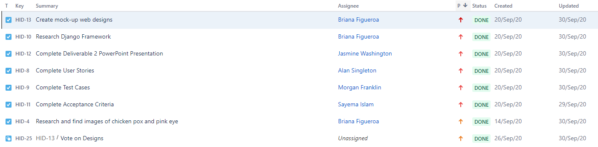
Sprint 2 backlog

Slide 29

Product backlog

Slide 30
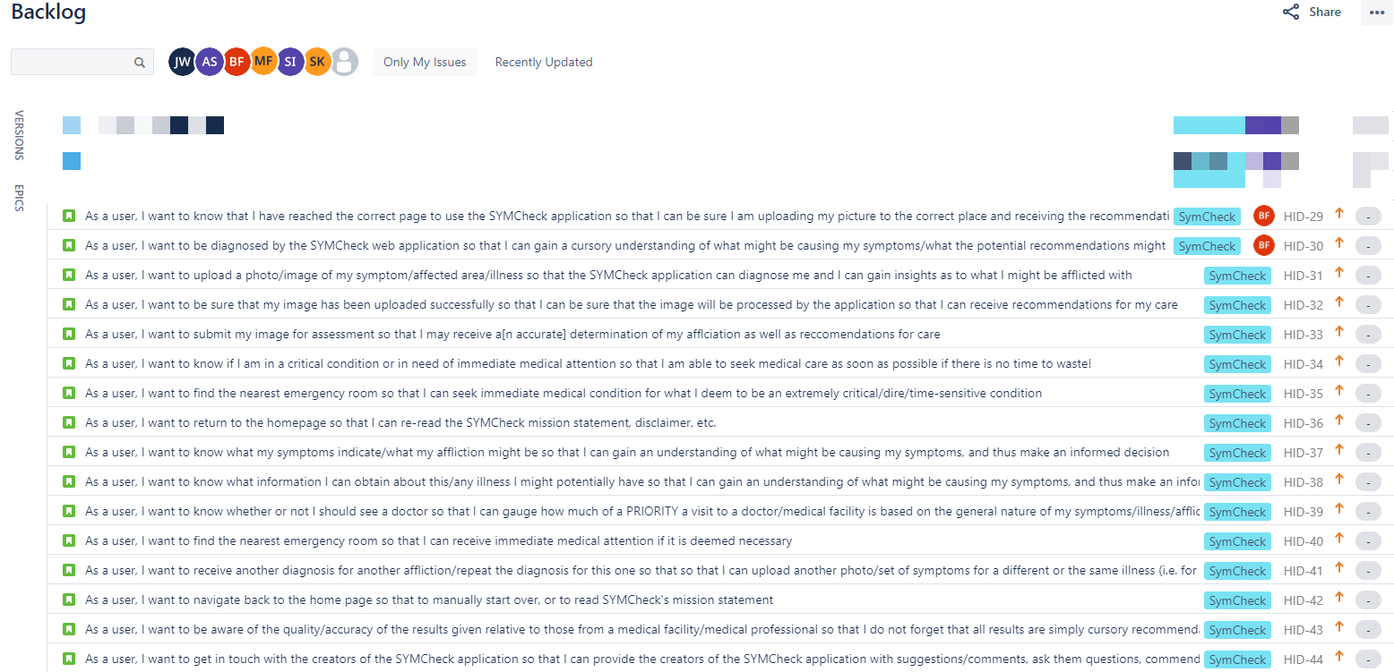
Story Artifacts

Slide 31
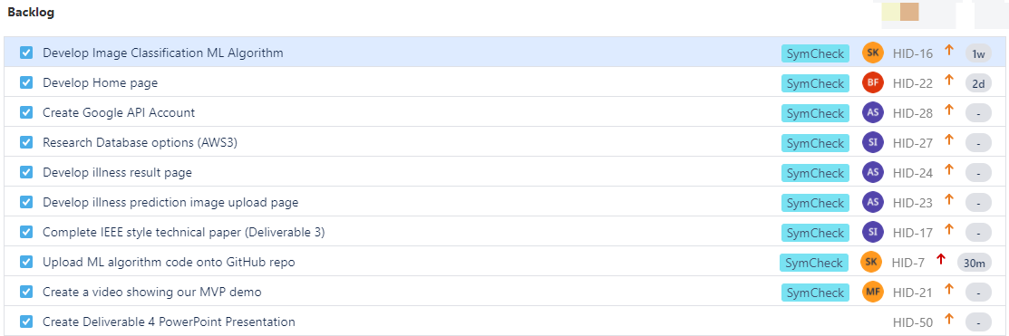
Task Artifacts

Slide 32

retrospectives

Slide 33
Top voted results
What went well
Tracking all progress on Jira/Confluence and looking over each other’s work.
What needs improvement
Follow through on final decisions made about features to the application.
Next Steps
During our weekly meetings, we go around and have each member of the team give a quick summary of what they’ve been working on/what they expect to be working on.

Slide 34

Future tasks

Slide 35
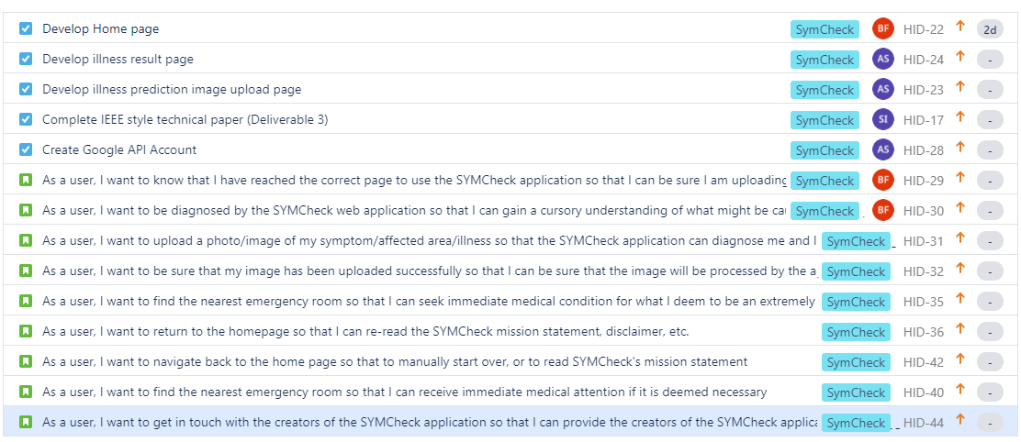
Sprint 3 to do list (10/4 – 10/26)

Slide 36

End GitHub Link https://github.com/jazzymaya/hiddenagility/wiki
Sources
https://www.wsj.com/articles/hospitals-treat-covid-19-they-spread-it-too-11594046342

